Slide 1
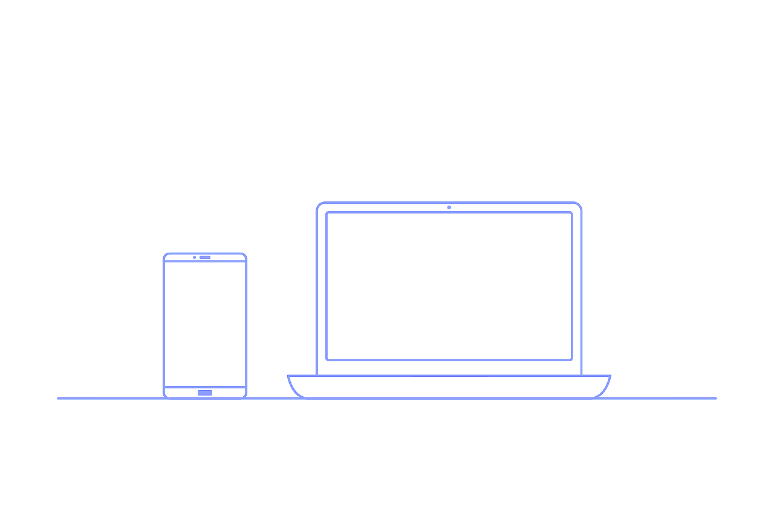
A Brief Report on TIC (Information and
Communication Technologies)
A Brief Report on TIC (Information and
Communication Technologies)
A Brief Report on TIC (Information and
Communication Technologies)
Project Members::
Youb Oussama
Sadeddine Nour Said
Zohair Benmakhloufi
Mokadem Abderaouf
Bachi Nassim

Slide 2
What is TIC?
TIC Is a broad term that encompass all technologies related to the creation, storage, exchange, and use of information.
This includes:
hardware (computers, smartphones..etc).
software (operating systems, applications).
telecommunication (internet, networks).

Slide 3
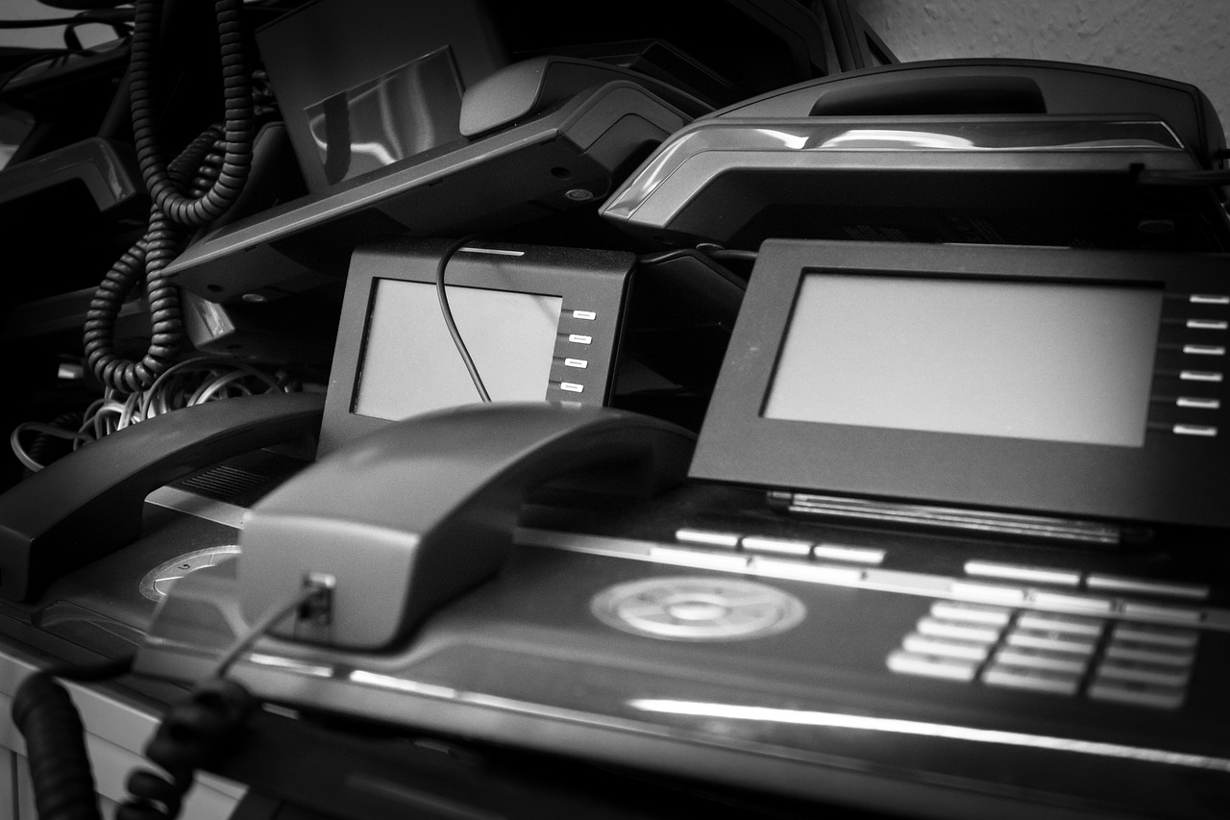
The History of Tic:
As for the history of Tic , It can be tracked back to the 19th century with the development of the telegraph and the telephone and Afterwards it developed To mass communication in the 20th century with :
the radio and television and by the end of the century, the Internet had become a mainstream tool for communication.

Slide 4
Economy of Tic
The money spent on IT worldwide has been estimated as US$3.8 trillion in 2017 and has been growing at less than 5% per year since 2009.
Here's a table that shows the Global IT industry market share (2020):
Country | USA | East Asia | EU | South Asia | Latin America | Africa | Eastern Europe | Canada
Percentage(%) | 32% | 21% | 20% | 11% | 6% | 5% | 3% | 2%

Slide 5
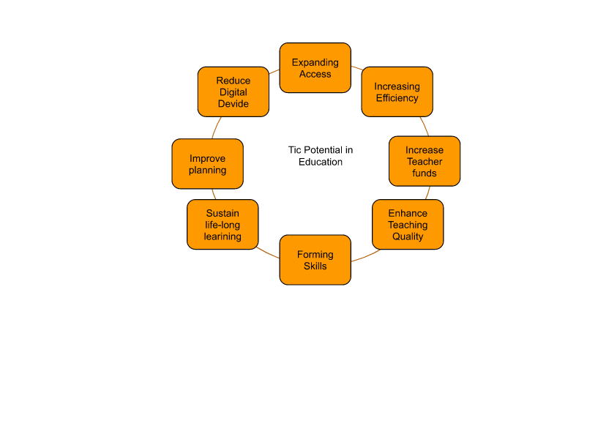
TIC As a subject in Education:
Tic has also become integral to the teaching-learning interaction, through such approaches as replacing chalkboards with interactive digital white boards, using student’s own smartphones...etc
Students Now watch lectures at home on the computer and use classroom time for more interactive exercises.

Slide 6

The main Innovators in TIC
Google has Innovated in Every Aspect
Google Search: The world's most popular search engine, providing access to information.
Gmail: Free email service with powerful features like spam filtering and large storage.
Google Maps: Navigation, location-based services, and real-time traffic information.
Google Drive: Cloud storage for files, enabling collaboration and easy access.
YouTube: Video-sharing platform, a hub for entertainment, education, and communication.

Slide 7
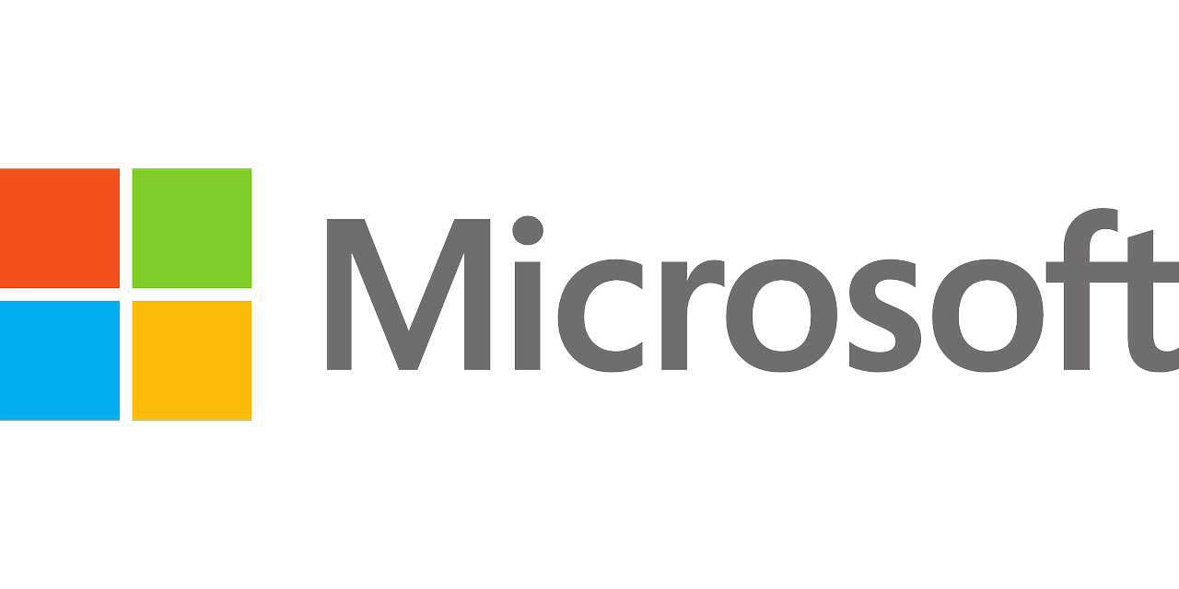
Microsoft: Leading with Impostant sevices including:
Microsoft Office Suite: Word, Excel, PowerPoint, essential tools for work and education.
Windows OS: The most widely used operating system for personal computers.
Microsoft Teams: Collaboration platform for communication, meetings, and teamwork.

Slide 8

Collaboration In TIC
Tic technology has opened up a new way for Software developent and made it easier with:
Git: A powerful version control system for tracking changes to code.
GitHub: A popular platform for hosting and sharing code using Git
Google services: Google docs, Google sheets, Google presentaions.. etc

Slide 9
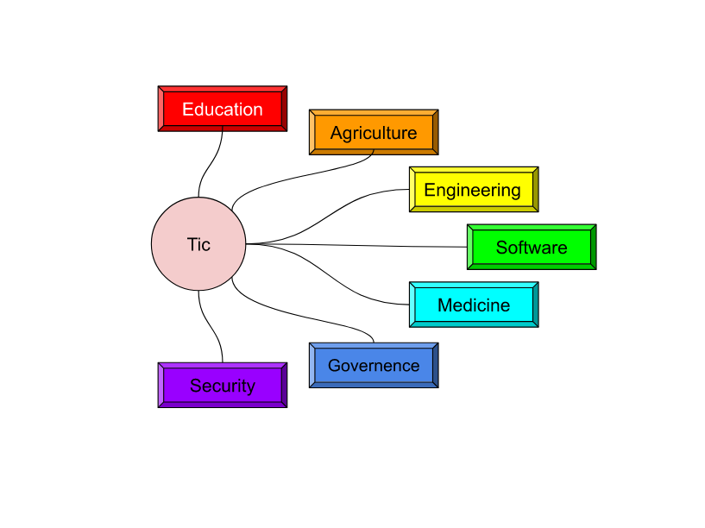
The Main Areas of TIC
Globalization: Connecting people and businesses across borders, fostering global trade and collaboration.
Education: Online learning platforms, access
to vast knowledge bases, personalized
learning experiences.
Medecine: Telemedicine, remote patient monitoring, research and development of new treatments.
Economy: Automation, e-commerce, digital marketplaces, creating new jobs and industries.

Slide 10
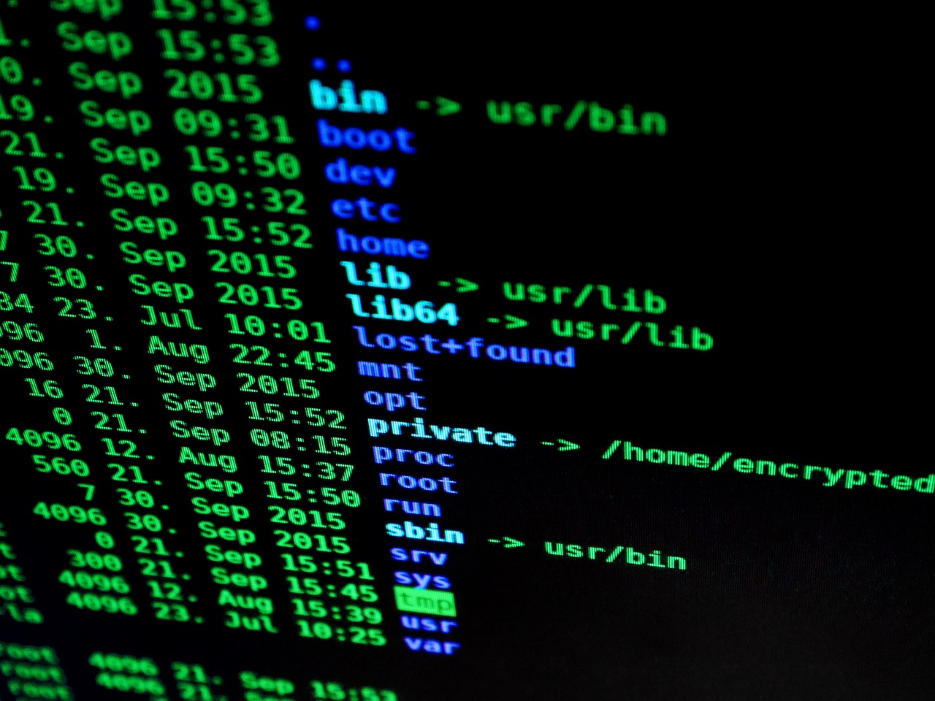
Modern day Challenges Associated with TIC
Digital divide: There exists a grave digital divide in the world wherein gaps exist in the usage of the internet and access to digital infrastructure.
Privacy concern: Recent advances threaten privacy and have reduced the amount of control over personal data and can have negative consequences
Cybersecurity threats: cybersecurity threats also Growing in frequency, vector, and complexity. Most notably viruses and Ransomware.

Slide 11
Conclusion
When we have a broad look on Tic, we can conclude that with Time the Domain of Tic is going to be more Advanced and going to have a big impact on future technologies,as world governments support it with more funds, combat it's challanges and integrate it into education systems and hospital..etc.

Slide 12

Thank you for your time!

